Slide 1
Review: Rate Equation for Enzymatic Reaction
experimentally determined reaction rate
E: enzyme S: substrate
ES: enzyme-substrate complex
Where:

Slide 2
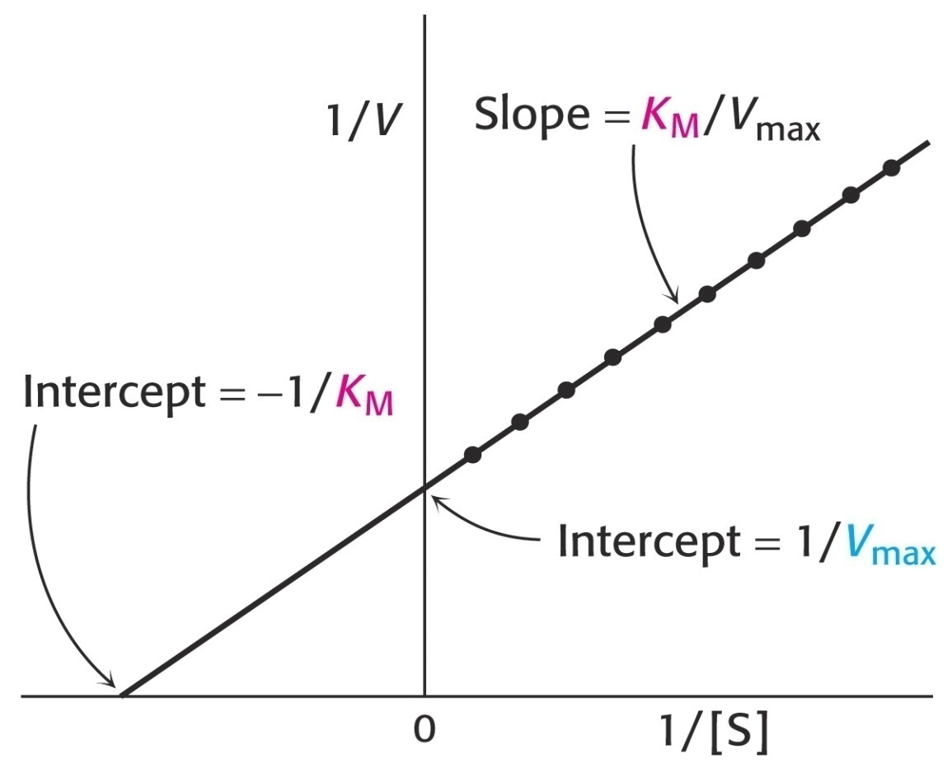
Review: Lineweaver-Burk Equation
Lineweaver & Burk: inverted the MM equation
By plotting 1/ V vs 1/C_{S},
a linear plot is obtained:
Slope = K_{m}/V_{max}
y-intercept = 1/V_{max}
x-intercept= -1/K_{m}

Slide 3
Review: Competitive Inhibition
Substrate and inhibitor
compete for same site
Slope = K_{m}/V_{max} y-int = 1/V_{max}
x-int= -1/K_{m}
K_{m, app} >K_{m}
V_{max, app} =V_{max}
Can be overcome by high substrate concentration

Slide 4
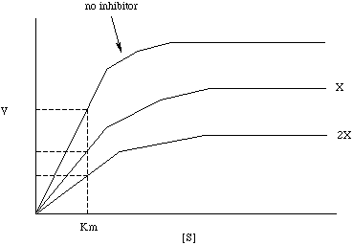
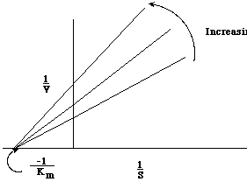
Review: Noncompetitive Inhibition
substrate and inhibitor bind different sites
Increasing
C_{I}
No I
V_{max}
V_{max,app}
r_{P}
C_{I}
V_{max,app}
higher C_{I}
K_{m}
C_{S}
V_{max, app} < V_{max}
K_{m, app} = K_{m}

Slide 5
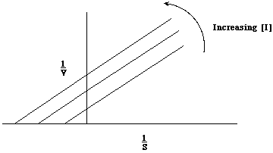
Review: Uncompetitive Inhibition
substrate & inhibitor bind different sites but I only binds after S is bound
No rxn
V_{max, app} < V_{max}
K_{m, app} <K_{m}
1/v
1/C_{S}
Notes:
For Lineweaver-Burk Plot, Both Km, apparent and Vm, apparent are smaller than Vmax and Km without inhibitor. Therefore both the y-intercept and x-intercept values change. However, the factor from the inhibitor cancels out, so the slope is Km/Vm.
E-H: the slope, Km, app, is decreasing as inhibitor increases and the y-intercept, Vmax, app, also decreases as the inhibitor increases.

Slide 6
Review: Kinetics of Microbial Growth (Batch or Semi-Batch)
Region 1: Lag phase
  microbes are adjusting to the new substrate
Region 2: Exponential growth phase
  microbes have acclimated to the conditions
Region 3:
Stationary phase
  limiting substrate or oxygen limits the growth rate
Region 4: Death phase
  substrate supply is exhausted
C_{C,max}
Log C_{C}
C_{C0}

Slide 7
Review: Quantifying Growth Kinetics
Relationship of the specific growth rate to substrate concentration exhibits the form of saturation kinetics
Assume a single chemical species, S, is growth-rate limiting
Apply Michaelis-Menten kinetics to cells→ called the Monod equation:
μ_{max} is the maximum specific growth rate when S>>K_{s}
C_{S} is the substrate concentration
C_{C} is the cell concentration
K_{s} is the saturation constant or half-velocity constant. Equals the rate-limiting substrate concentration, S, when the specific growth rate is ½ the maximum
Semi-empirical, experimental data fits to equation
Assumes that a single enzymatic reaction, and therefore substrate conversion by that enzyme, limits the growth-rate

Slide 8
Review: Monod Model
First-order kinetics:
Zero-order kinetics:

Slide 9
L11: Thermochemistry for
Nonisothermal Reactor Design
The major difference between the design of isothermal and non-isothermal reactors is the evaluation of the design equation
  What do we do when the temperature varies along the length of a PFR or when heat is removed from a CSTR?
  Today we will start nonisothermal reactor design by reviewing energy balances
  Monday we will use the energy balance to design nonisothermal steady-state reactors
Nonisothermal
Energy balance

Slide 10

Why do we need to balance energy?
F_{A0}
F_{A}
X_{A} = 0.7
Consider an exothermic, liquid-phase reaction operated adiabatically in a PFR (adiabatic operation- temperature increases down length of PFR):
Mole balance:
Arrhenius Equation
Rate law:
Stoichiometry:
Need relationships:
X T V
We can get them from the energy balance

Slide 11
Clicker Question
    The concentration of a reactant in the feed stream (inlet) will be greatly influenced by temperature when the reactant is
      a gas
      a liquid
      a solid
      either a gas or a liquid
      extremely viscous
Hints:
Liquid& solid phase:
Gas phase:

Slide 12

Thermodynamics in a Closed System
First law of Thermodynamics
  Closed system: no mass crosses the system’s boundaries
δQ
δW
dÊ: change in total energy of the system
δQ: heat flow to system
δW: work done by system on the surroundings

Slide 13
Thermodynamics in an Open System
Open system: continuous flow system, mass crosses the system’s boundaries
Mass flow can add or remove energy
F_{in}
F_{out}
H_{in}
H_{out}
Ẇ
Energy balance on system:
Rate of accum of energy in system
work done by system
energy added to sys. by mass flow in
energy leaving sys. by mass flow out
Heat in
=
-
+
-
Let’s look at these terms individually

Slide 14
The Work Term, Ẇ
Ẇ: Rate of work done by the system on the surroundings
Work term is separated into “flow work” and “other work”.
  Flow work: work required to get the mass into and out of system
  Other work includes shaft work (e.g., stirrer or turbine)
other work (shaft work)
Flow work
P : pressure
Plug in:
Heat in
Energy & work added by flow in
Accum of energy in system
=
Other work
-
Energy & work removed by flow out
-
+

Slide 15
The Energy Term, E_{i}
Heat in
Energy & work added by flow in
Accum of energy in system
=
Other work
-
Energy & work removed by flow out
-
+
Electric, magnetic, light, etc.
Internal energy
Potential energy
Kinetic energy
Usually:
Internal energy is major contributor to energy term
Plug in U_{i} for E_{i}:

Slide 16
Total Energy Balance
Recall eq for enthalpy, a function of T
unit : (cal / mole)
Steady state:
Accumulation = 0 = in - out + flow in – flow out

Slide 17
In Terms of Conversion:
Steady state:
If X_{A0}=0, then:
Multiply out:
Total energy balance (TEB)
Relates temperature to X_{A}
Must use this equation if a phase change occurs

Slide 18
What is (H_{i0} – H_{i})?
What is the heat of reaction for species i (H_{i})?
Enthalpy of formation of i at reference temp (T_{R}) of 25 °C
Change in enthalpy due to heating from T_{R} to rxn temp T
When NO phase change occurs & heat capacity is constant:

Slide 19
What is ΔH_{RX}(T)?
How do we calculate ΔH_{RX}(T), which is the heat of reaction at temperature T?
For the generic reaction:

Slide 20
Example: Calculation of ΔH_{RX}(T)
For the reaction N₂ (g) + 3H₂ (g) → 2NH₃ (g), calculate the heat of reaction at 150 °C in kcal/mol of N₂ reacted.
Extra info:

Slide 21
Example: Calculation of ΔH_{RX}(T)
For the reaction N₂ (g) + 3H₂ (g) → 2NH₃ (g), calculate the heat of reaction at 150 °C in kcal/mol of N₂ reacted.
Extra info:
Convert T and T_{R} to Kelvins

Slide 22
Example: Calculation of ΔH_{RX}(T)
For the reaction N₂ (g) + 3H₂ (g) → 2NH₃ (g), calculate the heat of reaction at 150 °C in kJ/mol of H₂ reacted.
Extra info:
Convert kcal to kJ
Put in terms of moles H₂ reacted

Slide 23
Q and H_{i} in Terms of T
Ignore enthalpy of mixing (usually an acceptable assumption)
Look up enthalpy of formation, H_{i}◦(T_{R}) in a thermo table, where the reference temperature T_{R} is usually 25◦C
Compute H_{i}(T) using heat capacity and heats of vaporization/melting
Phase change at T_{m} (solid to liquid):
Solid at T_{R}
melting
For T_{m} < T < T_{b}
←boiling
If constant of average heat capacities are used, then:
For T_{m} < T < T_{b}

Slide 24
Insert ΔH_{RX}(T) & (H_{i0} – H_{i}) into EB
(T_{i0} – T) = - (T – T_{i0})
Example calculations of ∆H°_{RX}(T_{R}) & ΔC_{p} are shown on the previous slides
If the feed does not contain the products C or D, then:

Slide 25
Clicker Question
Accum of energy in system
Energy & work added by flow in
Heat in
Other work
-
Energy & work removed by flow out
=
-
+
    If the reactor is at a steady state, which term in this equation would be zero?
      dE_{sys}/dt
      Ẇ
      F_{A0}
      ∆C_{P}
At the steady state:

Slide 26
How do we Handle Q in a CSTR?
CSTR with a heat exchanger, perfectly mixed inside and outside of reactor
F_{A0}
T, X
T_{a}
T_{a}
T, X
The heat flow to the reactor is in terms of:
Overall heat-transfer coefficient, U
Heat-exchange area, A
Difference between the ambient temperature in the heat jacket, T_{a}, and rxn temperature, T

Slide 27
Tubular Reactors (PFR/PBR):
Integrate the heat flux equation along the length of the reactor to obtain the total heat added to the reactor :
a: heat-exchange area per unit volume of reactor
Heat transfer to a perfectly mixed PFR in a jacket
For a tubular reactor of diameter D, a = 4 / D
For a jacketed PBR (perfectly mixed in jacket):
Heat transfer to a PBR

